Slide 1
QXU4004 Engineering Chemistry
Dr Sulafudin Vukusic
s.vukusic@qmul.ac.uk

Slide 2
Suggested Reading List:
Chapter 5, 15, 16 and 19: Brown et al. Chemistry the central science,14th int Ed, Pearson / ISBN:978-1-292-02152-2
https://www-vlebooks-com.ezproxy.library.qmul.ac.uk/vleweb/Product/Index/979714?page=0
(See QMPLUS for link)

Slide 3
QXU4004 Engineering Chemistry
Chemical Thermodynamics
& Acids and Bases

Slide 4
Chemical processes
Combustion (traditionally used for heating: burning wood, gas, coal and other fuels): energy is released in this process, in the form of heat.
Thermochemistry Chapter 5 (“Chemistry the Central Science, by Brown)
Chemical reactions involve breaking chemical bonds and forming new ones.
If the bonds broken are more stable (= lower energy) than the newly formed bonds, then energy is required for the process to occur
If the bonds broken are less stable (= higher energy) than the newly formed bonds, then energy is released in the process
This energy change as we go from reactants to products usually takes the form of a change in heat or heat transfer
This heat change is called enthalpy change, or ΔH (measured in J, joule (scientists) or cal, calories (engineers), normally in kJmol⁻¹ (ΔH depends on quantity reacted, measured in moles)

Slide 5
Chemical processes
Combustion (traditionally used for heating: burning wood, gas, coal and other fuels): energy is released in this process, in the form of heat.
Thermochemistry Chapter 5 (“Chemistry the Central Science, by Brown)
ΔH (Δ is the capital greek letter “delta”, you may have seen the small “delta”: δ. Δ is used to mean “change”, on its own above a reaction arrow “→” it means heat or energy needs to be input for the reaction to proceed in the direction of the arrow).
The heat change, or enthalpy change between products and reactants, ΔH is implied to mean: ΔH = H_{products} – H_{reactants}
This equation indicates that if the bonds in the products are lower energy than in the reactants, ΔH<0 (negative)
This equation indicates that if the bonds in the products are higher energy than in the reactants, ΔH>0 (positive)

Slide 6
Chemical processes
Thermochemistry Chapter 5 (“Chemistry the Central Science, by Brown)
Combustion (traditionally used for heating: burning wood, gas, coal and other fuels): energy is released in this process, in the form of heat.
The heat change, or enthalpy change between products and reactants, ΔH is implied to mean: ΔH = H_{products} – H_{reactants}
It’s important to remember that we can only measure energy changes! Therefore only ΔH can be measured, not H_{products} or H_{reactants}
However, we can use Hess law to calculate various ΔH (and H) values
Hess’s law states that if a reaction is a series of steps of other reactions, the overall ΔH will be the sum of ΔH for each step
For example, if we cannot measure ΔH for A→B (ΔH_{A→B}), but we know ΔH for A→C (ΔH_{A→C}) and ΔH for C→B (ΔH_{C→B}), then:
ΔH_{A→B} = ΔH_{A→C} + ΔH_{C→B}

Slide 7
Chemical processes
Thermochemistry Chapter 5 (“Chemistry the Central Science, by Brown)
Hess’s law also demonstrates that ΔH_{A→B} = - ΔH_{B→A} (because ΔH_{A→A} = 0)
This means that the enthalpy change from reactants to products is the same value but opposite sign of the enthalpy change from products to reactants (the opposite reaction)
Of course, this is easy to deduct from ΔH_{react→prod} = H_{products} – H_{reactants}
Since ΔH_{prod→react} = H_{reactants} – H_{products} then: ΔH_{react→prod} = - ΔH_{prod→react}
Terminology: if ΔH<0 (negative) the reaction is exothermic (from “exo” meaning “out of”, and thermos: heat) (Heat is released from the reaction into the environment: combustion is exothermic, used for heating)
Terminology: if ΔH>0 (positive) the reaction is endothermic (from “endo” meaning “into”, and thermos: heat) (Heat is extracted from the environment into the process/reaction)

Slide 8
Chemical processes
Chemical Thermodynamics : Chapter 19 (“Chemistry The Central Science” by Brown)
It is tempting to think that reactions will process a pathway that leads to more stable chemicals (= lower energy bonds in the products)
Therefore, it is tempting（吸引人的） to think that reactions where ΔH<0 (negative) (exothermic) are always favoured, or are “spontaneous” (Spontaneous: a process which occurs on its own, without outside assistance or intervention)
HOWEVER, ΔH is not the only consideration to determine whether a reaction is spontaneous(自发的), although, ΔH is indeed relevant, and ΔH<0 (negative) helps to make a process spontaneous (but not always, some reactions where ΔH>0 (positive) (endothermic) are also spontaneous
The other consideration is entropy!（熵） (S), or rather entropy change (ΔS)

Slide 9
Chemical processes
Chemical Thermodynamics : Chapter 19 (“Chemistry The Central Science” by Brown)
Entropy (S), is sometimes defined as a measure of chaos, randomness or disorder in the universe
Entropy (S) is better defined as a tendency of energy to disperse（分散） reducing its ability to be converted into work
The tendency is for the entropy of the universe to increase (2nd law of thermodynamics) (note that the reference to “the universe” means this tendency involves not only the process/reaction itself by also the environment). Such processes are spontaneous.
In a reaction, exactly like ΔH, ΔS_{react→prod} = S_{products} – S_{reactants}
Therefore, the tendency is for ΔS>0 (positive). HOWEVER: because the important criterion(尺度准则) is ΔS>0 for the universe (“universe”: reaction+environment), some reactions where ΔS<0 (for the reaction itself) can be spontaneous (if ΔS for the universe is ΔS>0)

Slide 10
Chemical processes
Chemical Thermodynamics : Chapter 19 (“Chemistry The Central Science” by Brown)
The units for Entropy (S) and Entropy change (ΔS) are J/K (joule per grade Kelvin) or kJ/K. As it also depends on quantities reacted, it is better expressed for reactions as J/mol*K or Jmol⁻¹K⁻¹
Entropy (S) and Entropy change (ΔS) can be associated with the degrees of freedom in a reaction or process: this means how many different possibilities can be associated with a state: imagine how many ways to arrange a number of molecules: at higher number of molecules, many more possibilities. If a molecule is very flexible, it can adopt many conformations, therefore, this is associated with a higher number of degrees of freedom.
At higher degrees of freedom, higher Entropy (S)
Therefore, if a process/reaction increases the degrees of freedom, it would result ΔS>0

Slide 11
Chemical processes
Chemical Thermodynamics : Chapter 19 (“Chemistry The Central Science” by Brown)
Therefore, if a process/reaction increases the degrees of freedom, it would result ΔS>0
Examples of significant changes in degrees of freedom:
A reaction in which there is a large change in number of molecules between reactants and products (for example polymerisations! MANY monomers form only 1 polymer chain, resulting in a significant ΔS value)
A reaction in which either products or reactants are in the gas state (but not both, for a large ΔS value) (S_{gas} > S_{liquid} > S_{solid})
2 C₇H₅N₃O₆ → 3 N₂ + 5 H₂ + 12 CO + 2 C
A reaction resulting in a large change of molecular flexibility (rotational or otherwise mobility of bonds) between reactants and products

Slide 12
Chemical processes
Chemical Thermodynamics : Chapter 19 (“Chemistry The Central Science” by Brown)
2nd Law of thermodynamics state that spontaneous processes are those where ΔS_{universe} > 0 (ΔS_{reaction} may be > 0 or < 0)
However, this is not easy to determine AND, we are interested in processes/reactions themselves
THEREFORE, how can we determine if a reaction is spontaneous without determining ΔS_{universe} ?
We consider another parameter: Gibbs Free Energy（吉布斯自由能）, G (G = H –TS)
And rather, ΔG (ΔG = ΔH – TΔS, T in K)
For spontaneous reactions ΔG < 0

Slide 13
Chemical processes
Chemical Thermodynamics : Chapter 19 (“Chemistry The Central Science” by Brown)
Examples
Esterification（酯化）
How do we determine that a reaction is likely? (We call it spontaneous or non-spontaneous)
We find out ΔG (Change in Gibbs Free Energy) for the specific reaction at specific conditions (pressure, temperature, and reactant concentrations) (if ΔG<0, the process is spontaneous)
ΔG = ΔH -TΔS

Slide 14
Chemical processes
Reactions and equilibria
Examples
Esterification
ΔG = ΔH –TΔS: is important (ΔG is the value at each condition)
but we can calculate and tabulate: ΔG⁰ = ΔH⁰ –TΔS⁰: (standard ΔG, ΔH, ΔS: 1 mole, 298K, 1 bar ~ 100kPa)
ΔG⁰ (for esterification above)= –4.38 kJ mol^{–1}

Slide 15
Chemical processes
Reactions and equilibria
Examples
ΔG⁰ = –4.38 kJ mol^{–1}
?
ΔG⁰ = –800.8 kJ mol^{–1}

Slide 16
Chemical processes
Reactions and equilibria
Examples
Esterification
ΔH: Enthalpy change (heat input or output)
Reactions can be exothermic (release heat, ΔH<0)
Or endothermic (require heat/take up heat, ΔH>0)
Esterification above ΔH⁰ = –2 kJ mol^{–1} (slightly exothermic)
ΔG = ΔH –TΔS (it means ΔH<0 -exothermic reactions- contribute to ΔG<0)

Slide 17
Chemical processes
Reactions and equilibria
Examples
ΔG⁰ = –4.38 kJ mol^{–1}
ΔH⁰ = –2 kJ mol^{–1}
?
ΔG⁰ = –800.8 kJ mol^{–1}
ΔH⁰ = –802.3 kJ mol^{–1}

Slide 18
Chemical processes
Reactions and equilibria
Examples
Esterification
ΔS: Entropy change (thermal energy unavailable for mechanical work)
S: (Entropy) usually referred to as the level of disorder (or “degrees of freedom”)
Larger number of molecules: larger S, More gas molecules: Larger S
Esterification above ΔH⁰ = +8 J mol^{–1}K^{–1}
ΔG = ΔH –TΔS (it means ΔS>0 –increase of disorder or degrees of freedom- contribute to ΔG<0)

Slide 19
Chemical processes
Reactions and equilibria
Examples
ΔG⁰ = –4.38 kJ mol^{–1}
ΔH⁰ = –2 kJ mol^{–1}
ΔS⁰ = +8 J mol^{–1} K⁻¹
?
ΔG⁰ = –800.8 kJ mol^{–1}
ΔH⁰ = –802.3 kJ mol^{–1}
ΔS⁰ = -5 J mol^{–1} K⁻¹

Slide 20
Chemical processes
Reactions and equilibria
Examples
Polyethylene
ΔG⁰ = –62.8 kJ mol^{–1}
ΔH⁰ = –109 kJ mol^{–1}
ΔS⁰ = -155 J mol^{–1} K⁻¹
?
ΔG⁰ = –800.8 kJ mol^{–1}
ΔH⁰ = –802.3 kJ mol^{–1}
ΔS⁰ = -5 J mol^{–1} K⁻¹

Slide 21
Chemical processes
Reactions and equilibria (Chapter 15, “Chemistry The Central Science” by Brown)
Esterification
ΔG⁰ = –4.38 kJ mol^{–1}
Reversible reaction (It can reach equilibrium)
?
Combustion
ΔG⁰ = –800.8 kJ mol^{–1}
Irreversible reaction (It cannot reach equilibrium)
Theoretically: All reactions are potentially reversible (but conditions may not have been found for it to happen)

Slide 22
Chemical processes
Reactions and equilibria (Chapter 15, “Chemistry The Central Science” by Brown)
Esterification
If the reaction reaches equilibrium: rate of forward reaction = rate of backward reaction (but they never stop)
This doesn’t mean that forward and backward reactions always occur: it could be the case that neither may occur at all: you need to find the necessary conditions for them to happen
Achieving or reaching equilibrium is not necessarily straightforward
Case-by-case (depending on structure)

Slide 23
Chemical processes
Reactions and equilibria
Esterification
Le Chatelier’s principle（勒夏特列原理）: When a system in equilibrium experiences a disturbance (change), it will respond in order to restore the equilibrium
Add reactants (increase forward reaction to decrease reactants) (viceversa with products/opposite reaction)
Decrease reactants （反应物）(increase opposite reaction to increase reactants) (viceversa with products and forward reaction)
Input heat: increase endothermic process to use up heat (and viceversa if heat is taken out)
Decreasing pressure can result in increase in gas production (if any) or increase process that leads to increased disorder.

Slide 24
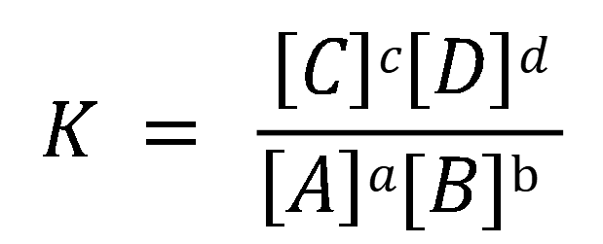
Chemical processes
Reactions and equilibria
Esterification
The extent of the equilibrium can be measured by an equilibrium constant（平衡常数）: K
aA + bB ⇌ cC + dD then
$$K = \frac{\left[C\right]c\left[D\right]d}{\left[A\right]a[B]\text{b} }$$

Slide 25
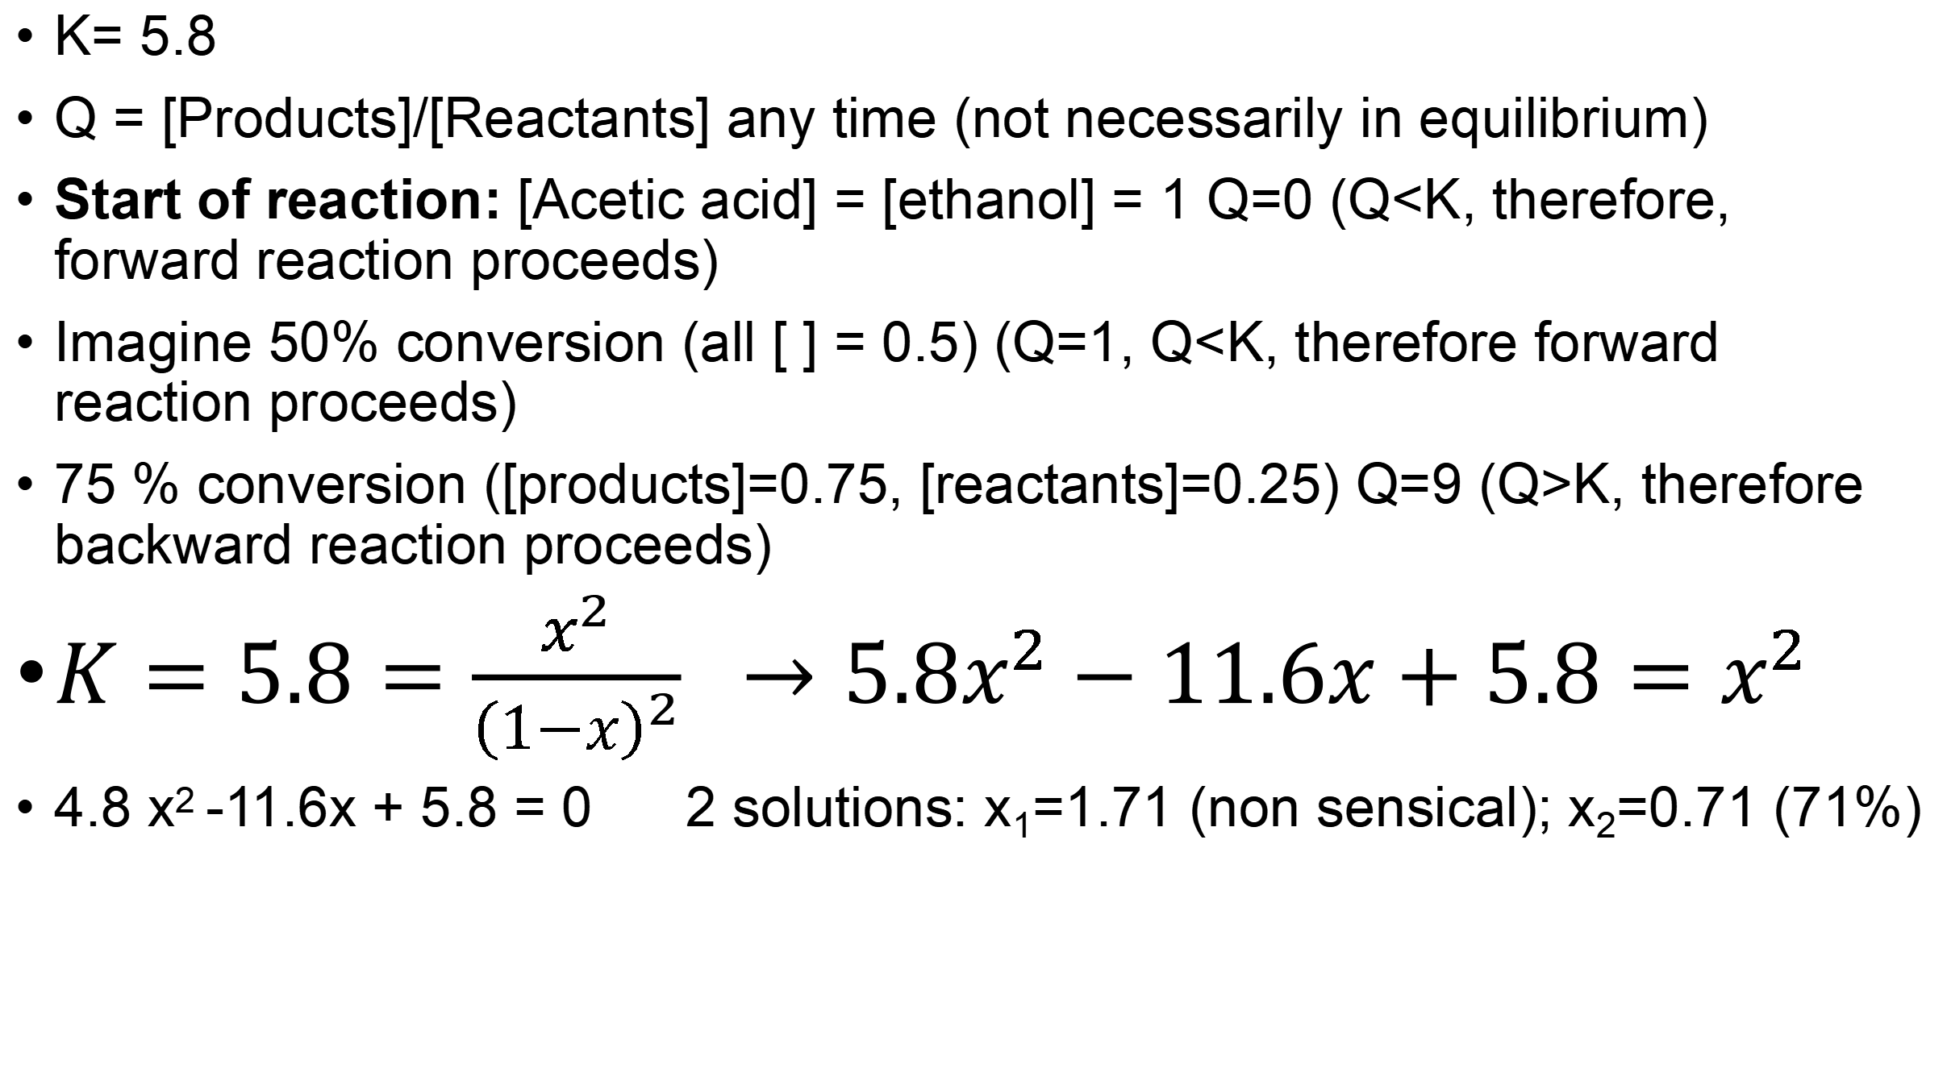
Chemical processes
Reactions and equilibria
K= 5.8
Q = [Products]/[Reactants] any time (not necessarily in equilibrium)
Start of reaction: [Acetic acid] = [ethanol] = 1 Q=0 (Q<K, therefore, forward reaction proceeds)
Imagine 50% conversion (all [ ] = 0.5) (Q=1, Q<K, therefore forward reaction proceeds)
75 % conversion ([products]=0.75, [reactants]=0.25) Q=9 (Q>K, therefore backward reaction proceeds)
$K=5.8=\frac{x^{2}}{{\left(1−x\right)}^{2}} →5.8x^{2}−11.6x+5.8=x^{2}$
4.8 x² -11.6x + 5.8 = 0 2 solutions: x₁=1.71 (non sensical); x₂=0.71 (71%)

Slide 26
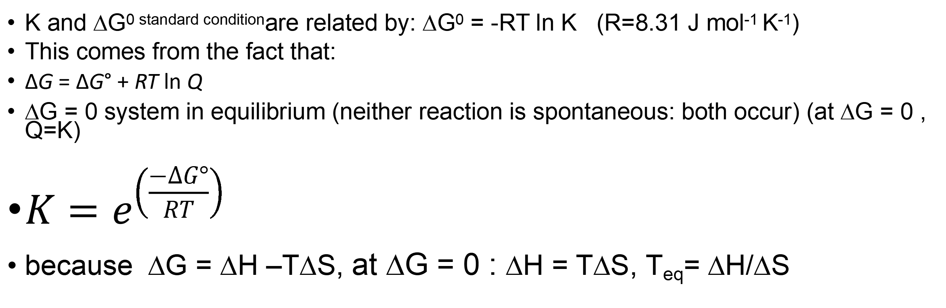
Chemical processes
Reactions and equilibria
Esterification
K and ΔG^{0 standard condition}are related by: ΔG⁰ = -RT ln K (R=8.31 J mol⁻¹ K⁻¹)
This comes from the fact that:
ΔG = ΔG° + RT ln Q
ΔG = 0 system in equilibrium (neither reaction is spontaneous: both occur) (at ΔG = 0 , Q=K)
${K=e}^{\left(\frac{−∆G°}{RT}\right)}$
because ΔG = ΔH –TΔS, at ΔG = 0 : ΔH = TΔS, T_{eq}= ΔH/ΔS

Slide 27
Chemical processes
Reactions and equilibria
ΔG⁰ = –4.38 kJ mol^{–1} ΔH⁰ = –2 kJ mol^{–1}
ΔS⁰ = +8 J mol^{–1} K⁻¹ K = 5.8 Using ΔH⁰ ΔS⁰ T_{eq}~250K
?
ΔG⁰ = –800.8 kJ mol^{–1} ΔH⁰ = –802.3 kJ mol^{–1}
ΔS⁰ = -5 J mol^{–1} K⁻¹ K > 10¹⁰⁰ Using ΔH⁰ ΔS⁰ T_{eq}~106,000K

